Slide 1
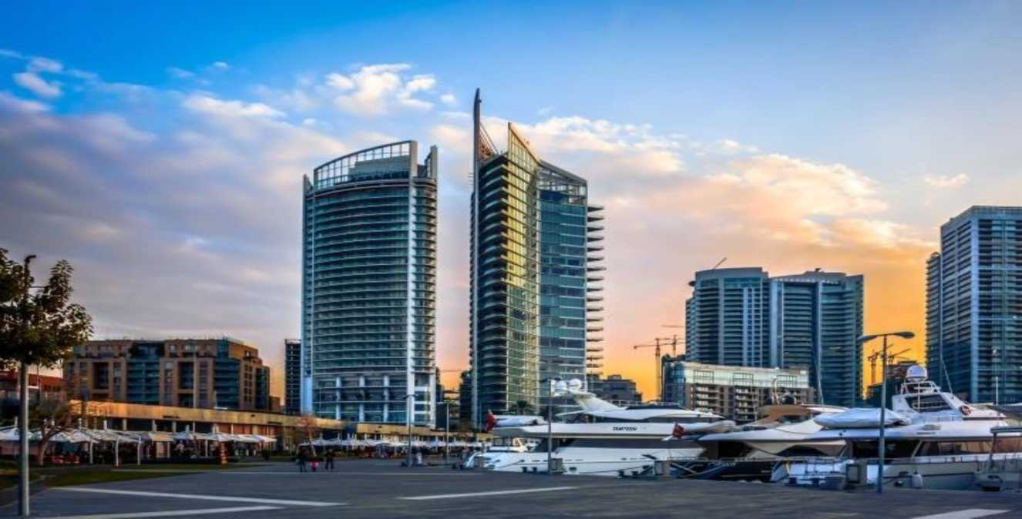
FOUR SEASONS HOTEL
Prepared by:
Hasan Itani
Omar Al Zoghbi
Omar Hamdan​

Slide 2
1. Acknowledgment
We would sincerely like to thank our doctor in the Software Engineering course, Dr. Nadine-Zbib, who guided us thoroughly throughout the entire process of this project. She helped lead the way with vivid ideas and enormous support. We also thank everyone who was part of this project in a variety of ways, thus supporting the idea of this project.

Slide 3
2. Introduction
• An hotel like the Four Seasons Hotel located in Beirut, particularly in the Rawche area,
necessitates a hotel reservation for several compelling reasons.
• Firstly, Beirut is a bustling cosmopolitan city with a thriving tourism industry, attracting visitors from around the world for business, leisure, and cultural exploration. As such, accommodations in prime locations like Rawche tend to be in high demand, especially at renowned luxury hotels like the Four Seasons. Making a reservation ensures that you secure your preferred dates and room type, avoiding any disappointment due to fully booked periods.

Slide 4
3. Functional & Nonfunctional Requirements
Requirements to know which functions are mandatory and those who are obligatory
Having an admin page | Functional
Customers can have white and dark mode | Nonfunctional
Customers can choose their type of breakfast | Nonfunctional
Able to add , remove reservations | Functional
Customers can choose their room number | Functional
Having malware and virus firewall | Functional
System must be friendly | Nonfunctional
System must be on power saving module | Nonfunctional

Slide 5
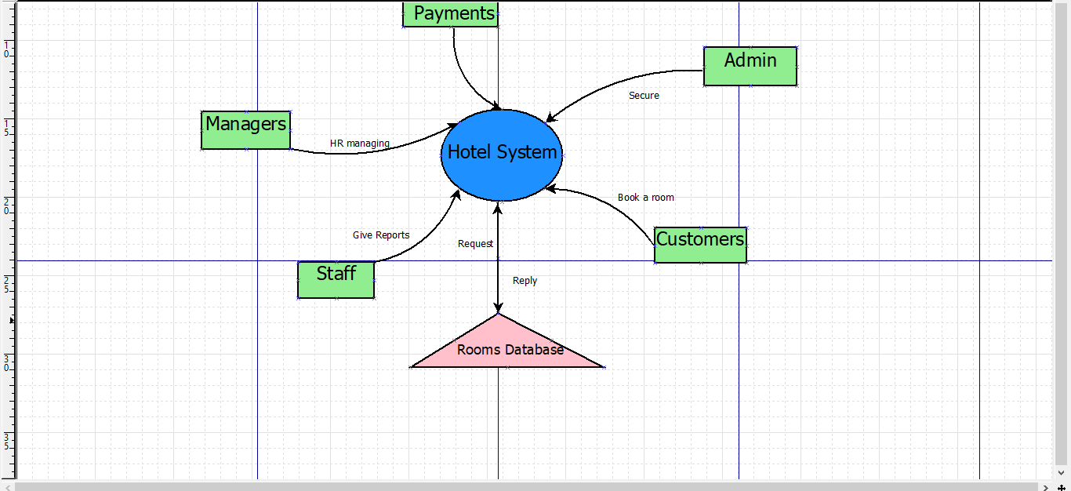
Briefly showing how the system is working
4. Context-Diagram
Level 0:​

Slide 6
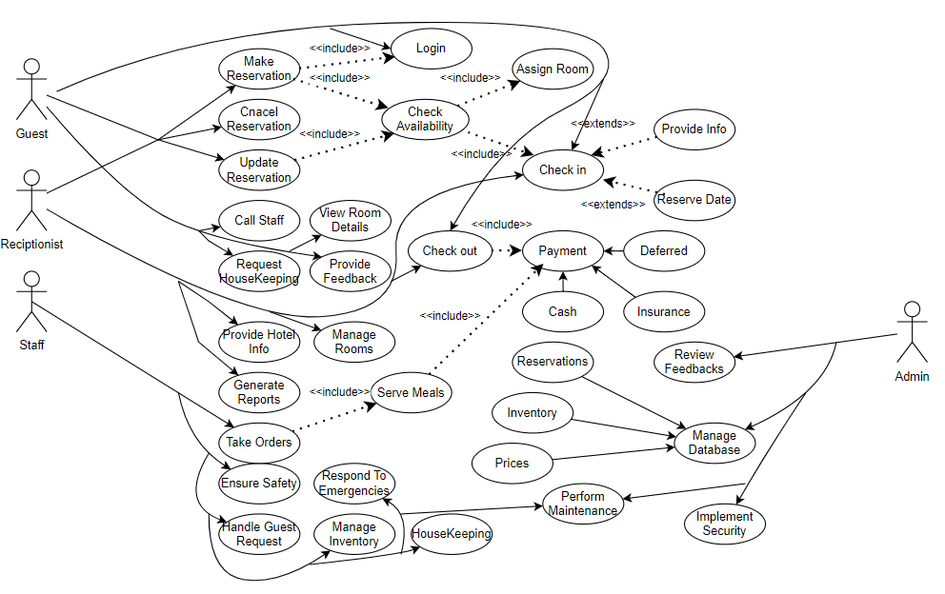
To show the interaction between the actor
and the action.
5. Use-Case Diagram

Slide 7
Taking one action and deeply justifying how it works and how the interaction is between the actor and the system.​
6. Use-Case Narrative
Use Case Name | Hotel Reservation System
Use Case Id | HSR1
Priority | High
Description | This use case describes an event in which a guest pays the bill after visiting the hotel to make a reservation and request the room and services needed
 | Actor Action | System Response
Precondition | 1) The Guest initiates the reservation process by providing their details and selecting their preferred room type and dates of stay. 4) The guest chooses the type of payment they wish to use for settling their bill. 5) Payment is processed securely through the selected payment method. | 2) The system checks the record of the guest to determine if they have stayed at the hotel before. 3) If it's the guest's first time, the system adds a new record to its database, capturing their information for future reference. 6) Once the payment is confirmed, the system completes the transaction, updating the guest's record accordingly and finalizing the reservation process.
Conclusion | The use case ends when the guest pays for the reservation Finally, hope you have a good stay

Slide 8
DFD shows the interaction between agents and the database using the process.​
7. Data Flow Diagram
Level 0:​

Slide 9
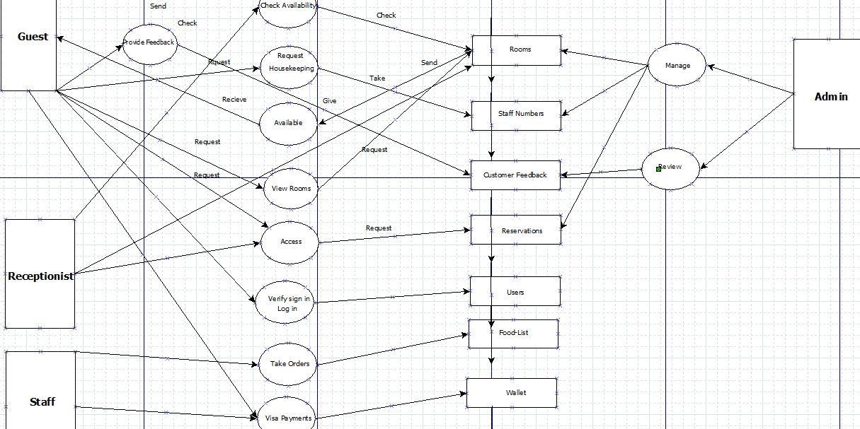
DFD shows the interaction between agents and the database using the process.​
7. Data Flow Diagram
Level 1:​

Slide 10
8. System Architecture
Case Study:
Four Seasons Hotel needed a new reservation system for their guests. Our Software engineering project delivered a system that increased bookings by 40% in a year. It's easy to use and reduces errors, making guests happier. Real -time updates and personalized options also boost customer loyalty and feedback. Our system not only streamlines booking processes but also enhances the overall guest experience, contributing to Four Seasons Hotel's reputation for exceptional service.

Slide 11
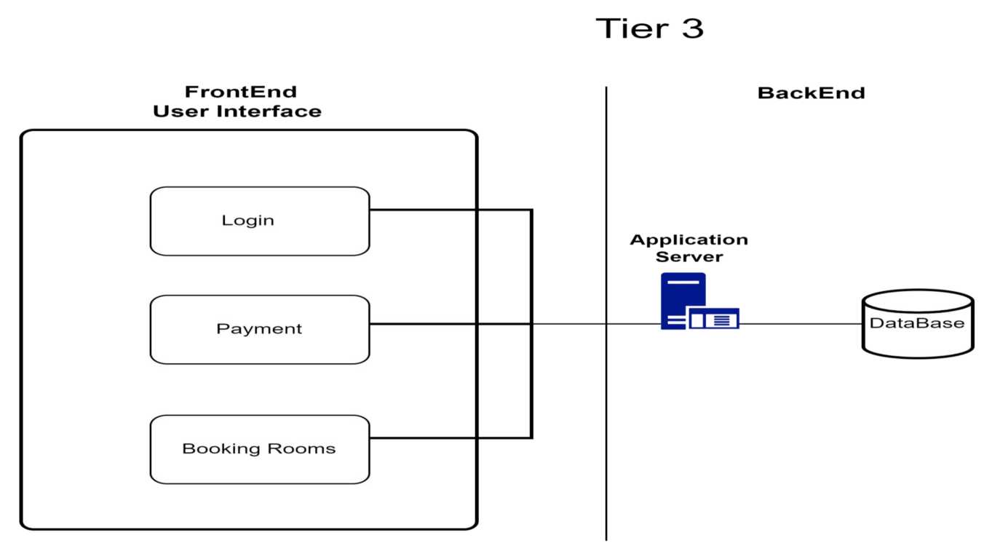
9. Architecture
Tier 3 support in hotel reservation systems addresses the most complex technical issues, handled by highly skilled engineers and developers. They tackle advanced troubleshooting, system bugs, and security breaches, ensuring long-term solutions. This level of support also manages software updates, patches, and performance enhancements. Their expertise guarantees smooth operation and reliability of the reservation system. Tier 3 support plays a crucial role in providing a seamless experience for hotel staff and guests.

Slide 12
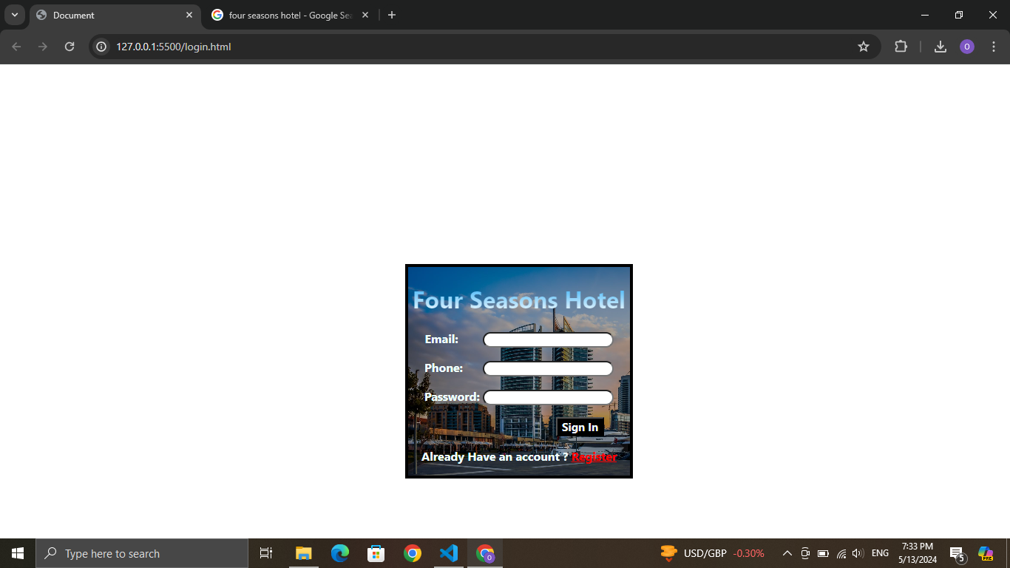
10.Graphical-User-Interface
The User will enter the credentials
The system will add the user to the database
If the user have an account,user can register

Slide 13
11. Conclusion
In conclusion, our hotel reservation system project for the Four Seasons Hotel in Beirut addresses the critical needs of a high-demand luxury accommodation provider. By implementing a robust, user-friendly system with essential functional and non-functional requirements, we enhance the booking experience for guests while streamlining administrative processes. The system's architecture, encompassing subsystems for login, room booking, and payment, ensures seamless and secure transactions. With advanced support structures like Tier 3 in place, the system guarantees reliability and efficiency. This project not only boosts booking rates and customer satisfaction but also upholds the Four Seasons Hotel's reputation for exceptional service and hospitality.

